Slide 1

IV-B.Tech (I-Semester) CSBS
Course Coordinator: KVLN Pavan Kumar
IV- B.Tech (I-Semester) CSBS
KVLN Pavan Kumar

Slide 2

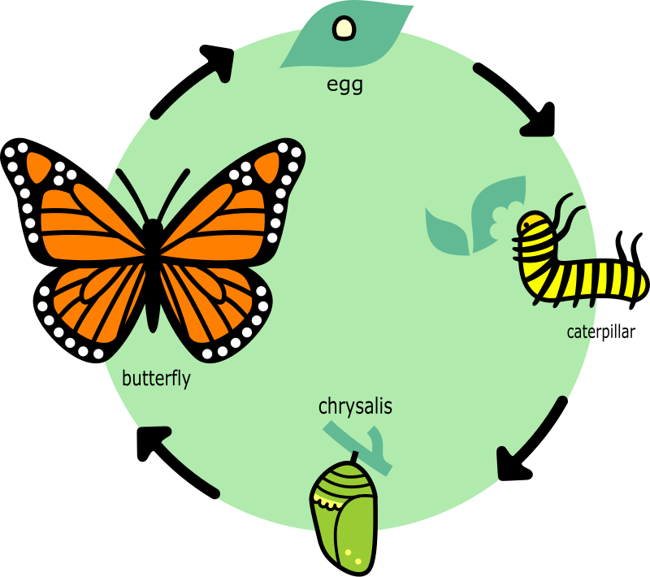
WIT & WIL

Slide 3
Financial Resources
Organizational Goals
Physical Resources
Human Resources

Slide 4

WHAT IS HR?????
UNIT-I HRM
Human resources is the set of individuals who make up the workforce of an organization, business sector or an economy.
Other terms sometimes used include "manpower", "talent", "labor" or simply "people“.
Notes:
Organizations are composed of people and these people represent one of the organizations most valuable assets. But the resource is seldom given any importance because the organization does not own people like its other capital and physical assets.

Slide 5
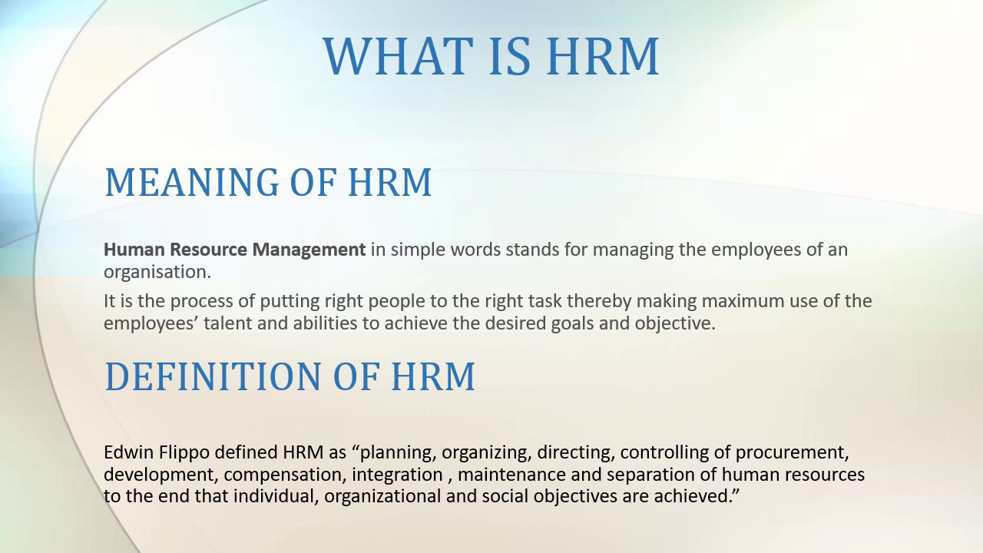
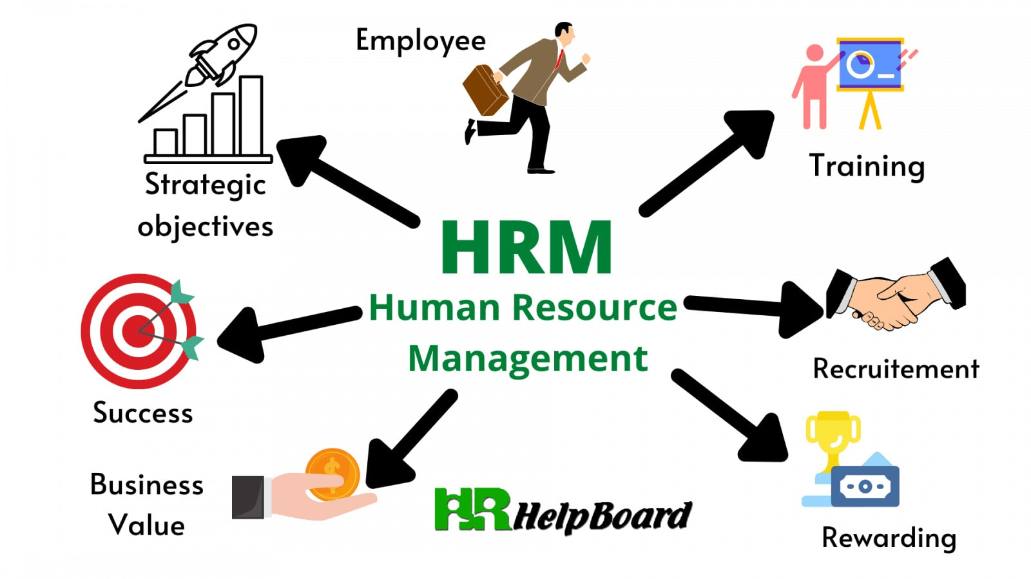


Slide 6
What is HRM?
The process of acquiring, training, appraising, and compensating employees, and of attending to their labor relations, health and safety, and fairness concerns.
A management function that helps managers recruit, select, train and develop members for an organization.
HRM may be defined as a set of policies, practices and programmes designed to maximize both personal and organizational goals.

Slide 7

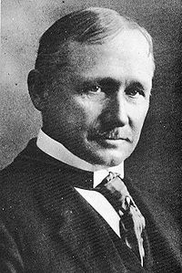
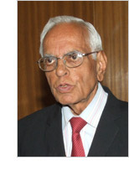

Some eminent personalities…
Dr. Udai Pareek
Dr. T V Rao
Frederick Winslow Taylor
King Hammurabi
Notes:
Frederick Winslow Taylor (March 20, 1856 – March 21, 1915). He was an American mechanical engineer who sought to improve industrial efficiency. He is regarded as the father of scientific management and was one of the first management consultants

Slide 8
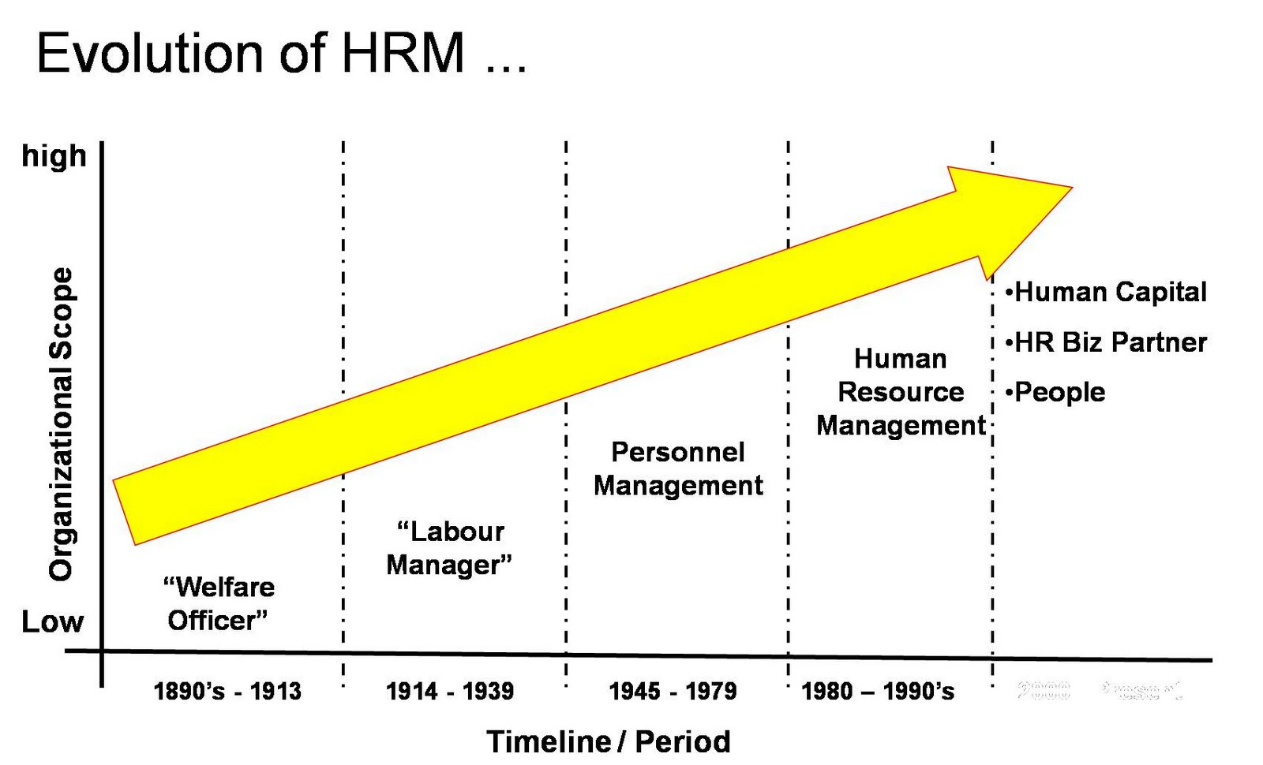
Evolution of HRM
assets
Procure, develop and motivate
Procure and develop

Slide 9
Nature of HRM
Integral part of process of management.
Comprehensive Function
Pervasive Function
People Oriented
Based on human relations
Continuous process
Science as well as art
Recent origin
Interdisciplinary
Basic to all functional areas.

Slide 10
Personnel Aspect
Welfare Aspect
Industrial Relation Aspect
Scope of HRM

Slide 11
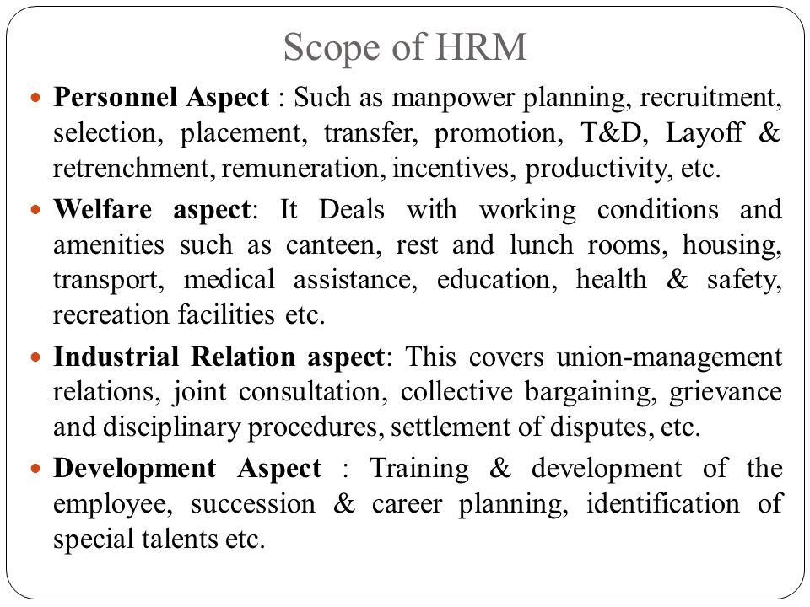

Slide 12
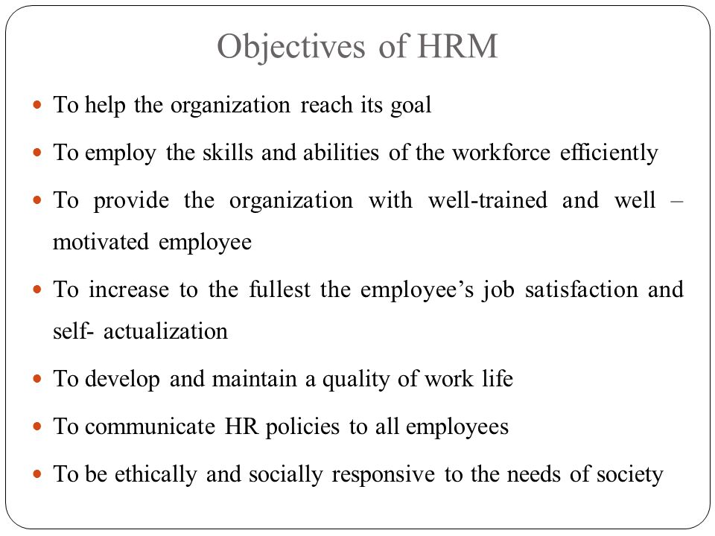

Slide 13
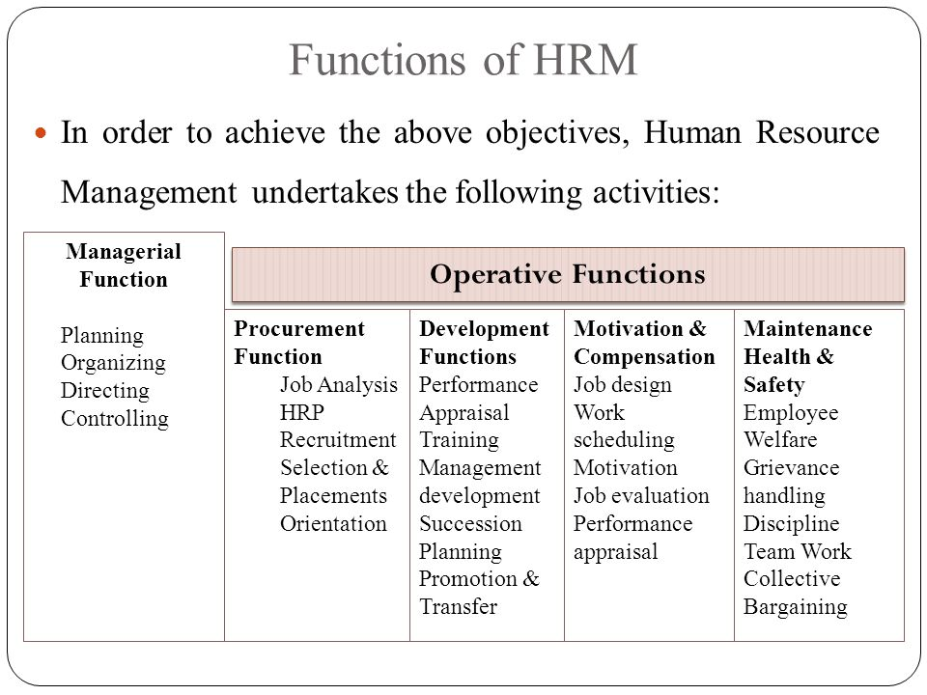

Slide 14
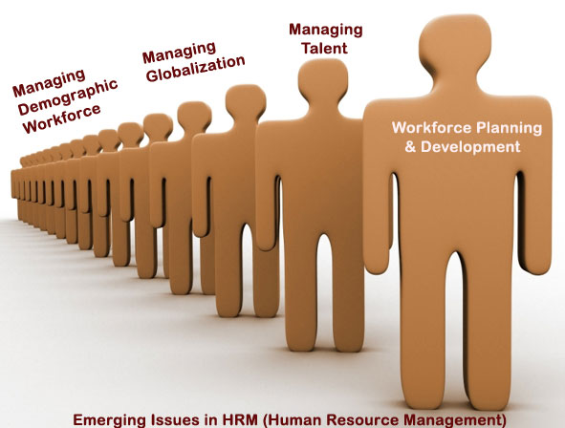
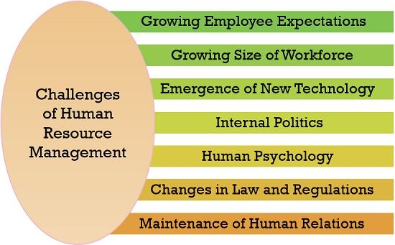

Slide 15

Policies, Principles and Procedures
Policy : A plan of action.. A statement of action committing management to a general course of action.
Principle: Fundamental truth established by research, investigation and analysis….guide the managers in formulating policies, programs and procedures.
Procedures: a method for carrying out a policy….

Slide 16
Equal Opportunities Policy; Discrimination in labor laws and being compliant with the laws.
Recruiting and Hiring.
Termination and Off boarding; At-will employment clause and any exceptions.
Salaries and Bonuses.
Performance Appraisals.
Safety.
Codes of Conduct: Sexual harassment, dress code, substance abuse; drug testing.
Scheduling; Lunch periods and other breaks.
Benefits: Vacations, holidays and sick time; health insurance; family leave
Use of Company Tools and Equipment: Email and internet use.
Conflict of Interest Statement.
Confidentiality Agreement.
Grievances.
Disciplinary Actions.

Slide 17
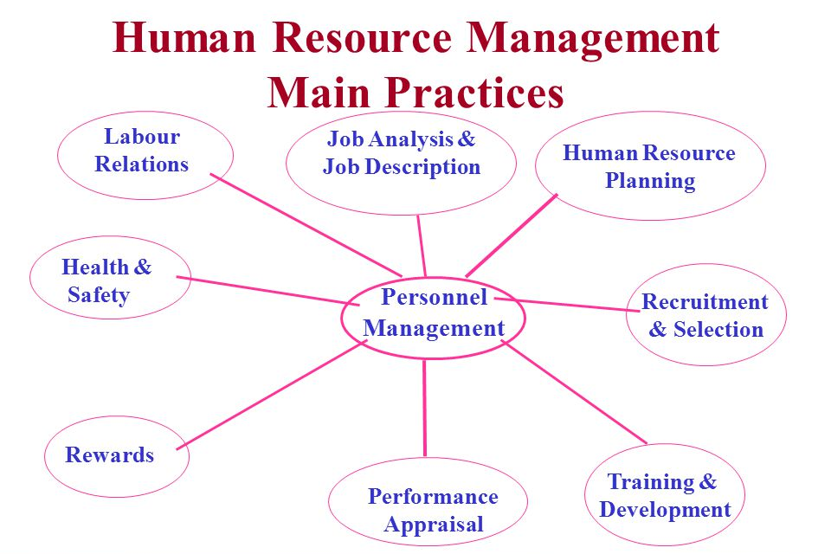

Slide 18
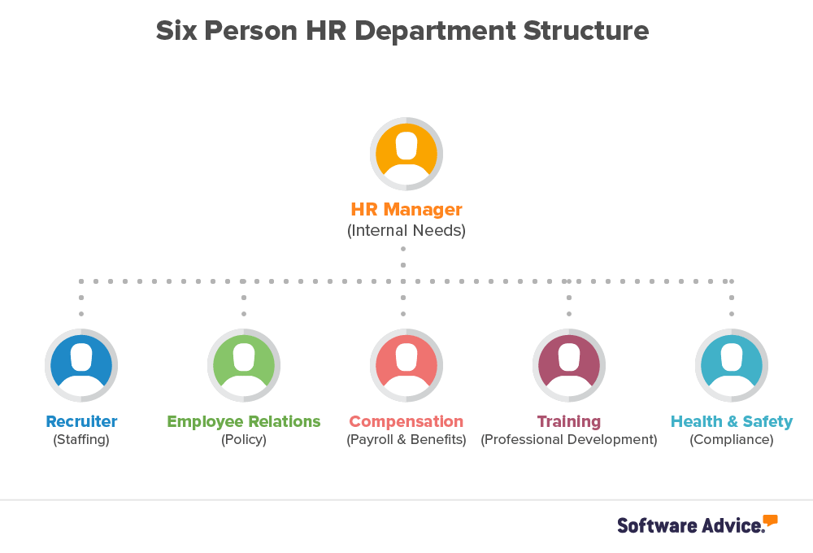
HR DEPARTMENT
Administration
Recruiting and staffing
Health and safety
Training and development
Compensation and benefits
Labor and employee relations
Disciplinary actions
New hire onboarding
Company policies
Diversity & inclusion

Slide 19
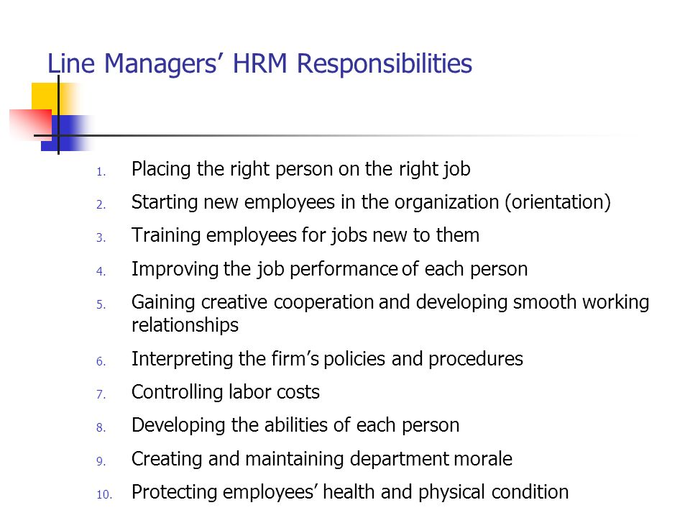

Slide 20
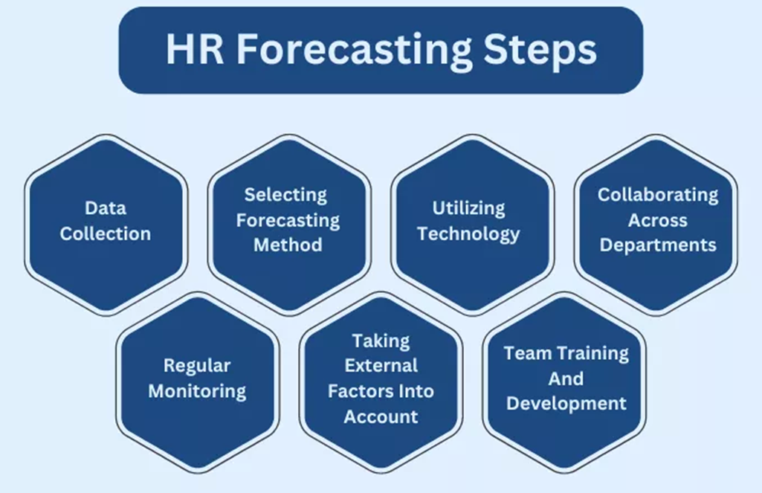
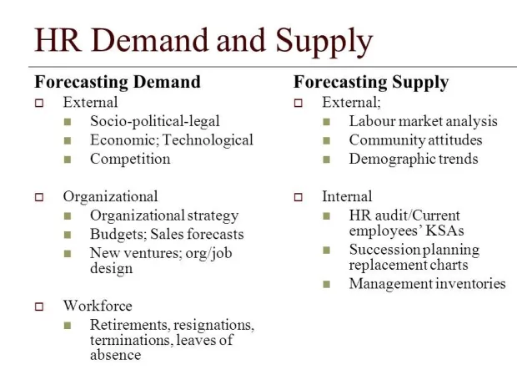

Slide 21
Importance:
Ensures workforce availability:
By forecasting demand, organizations can proactively recruit, train, and develop employees, ensuring they have the right talent to meet business needs.
Reduces costs:
Accurate forecasting helps minimize overstaffing or understaffing, reducing unnecessary expenses related to recruitment, training, and potential productivity losses.
Supports strategic planning:
Demand forecasting aligns with overall business strategies, enabling organizations to adapt to changing market conditions and achieve their goals effectively.
Enhances employee engagement:
By anticipating future needs and providing development opportunities, organizations can improve employee engagement and retention.
Addresses skills gaps:
Forecasting helps identify potential skills gaps and allows organizations to implement targeted training and development programs.

Slide 22
Qualitative Methods:
Delphi Technique: This method uses iterative rounds of questionnaires to solicit and refine expert opinions on future HR needs. Anonymity and feedback loops help reduce bias and facilitate consensus building.
Nominal Group Technique (NGT): This structured method involves individual idea generation followed by round-robin sharing, group discussion, and anonymous voting to prioritize and reach a consensus on HR demand.
Scenario Planning: This technique involves developing multiple "what-if" scenarios (e.g., best-case, worst-case) to anticipate potential future HR needs and formulate flexible HR plans.
Managerial Judgment: This straightforward approach relies on the insights and experience of managers and departmental heads to estimate future workforce needs. It can be implemented using a bottom-up (managers submit departmental needs to top management) or top-down approach (top management forecasts and distributes for review).
Expert Executive Opinion: This method leverages the insights and experience of internal and external experts to forecast future HR demands.
Quantitative methods
These methods use numerical data and mathematical models to predict future staffing requirements.
Trend Analysis: This technique involves analyzing historical workforce data (e.g., employee numbers, hiring rates) to identify patterns and trends, which are then extrapolated to predict future demand.

Slide 23



Ratio Analysis: This method establishes relationships between workforce demand and business drivers like revenue, production volume, or sales per employee, to forecast future staffing needs.
Regression Analysis: This statistical technique identifies mathematical relationships between workforce demand and multiple independent variables (e.g., economic indicators, industry trends) to create more robust and accurate forecasts, particularly in dynamic environments.
Workload Analysis: This method involves assessing the amount of work required for specific tasks and the time it takes to complete them, allowing for calculation of the number of employees needed to meet workload demands.
Flow Models (e.g., Markov Model): This technique analyzes historical employee movement within the organization (e.g., promotions, transfers, exits) to predict internal labor supply and identify potential vacancies or surpluses.
Econometrics Models: These models utilize mathematical and statistical techniques to establish relationships between HR demand and other economic and organizational variables for more precise forecasting.
Simulation Modeling: This method creates a virtual representation of the organization's workforce dynamics and allows HR professionals to simulate various scenarios and predict workforce needs under different conditions.

Slide 24
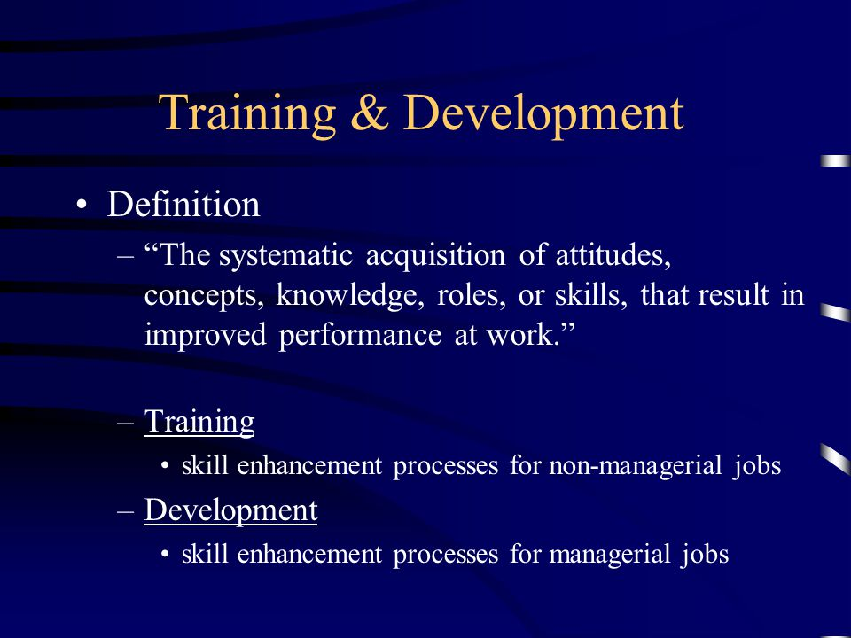

Slide 25
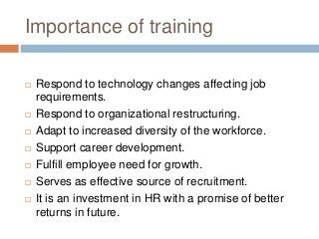

Slide 26
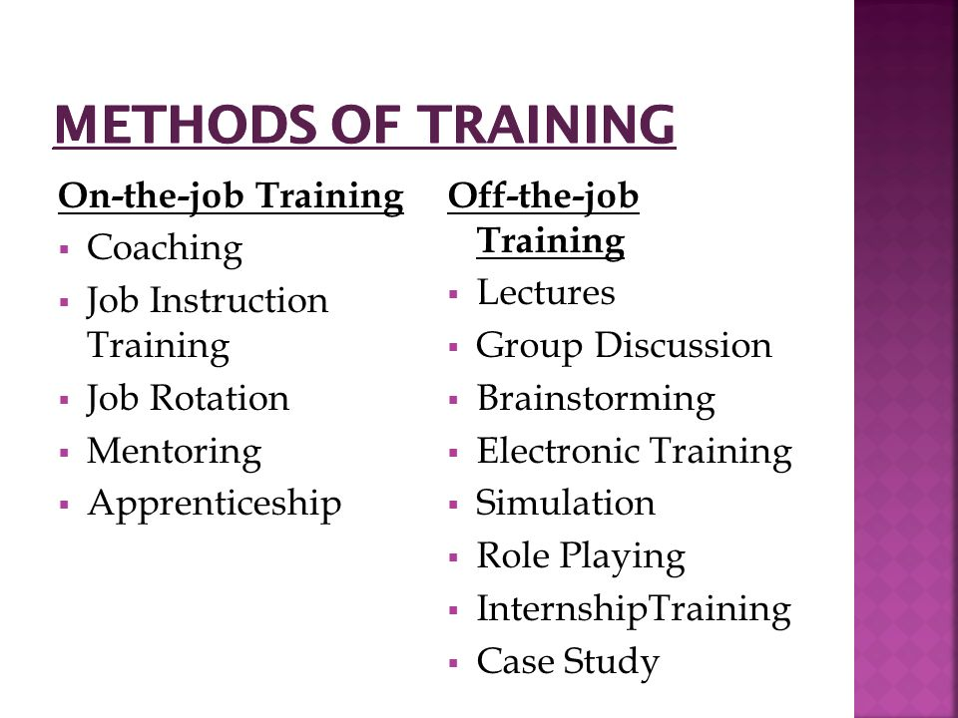

Slide 27
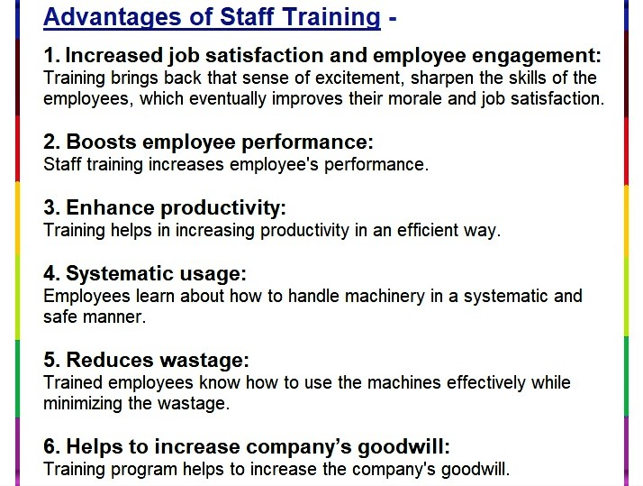

Slide 28
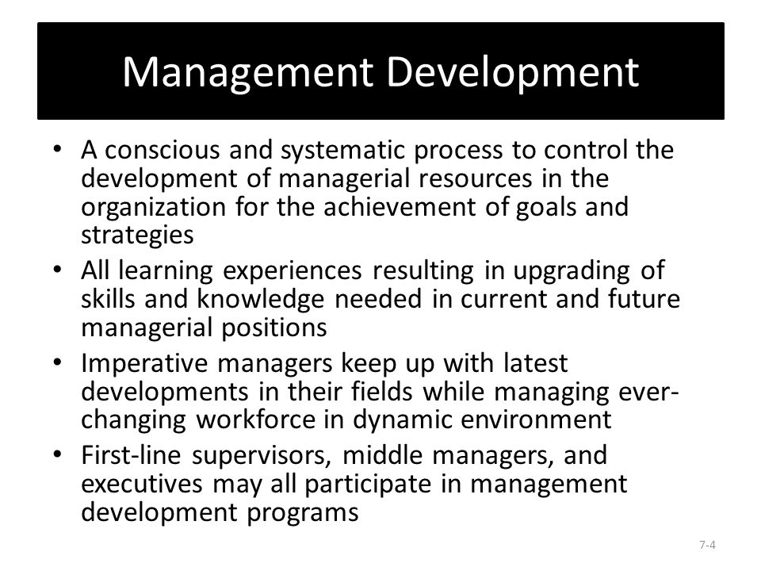

Slide 29
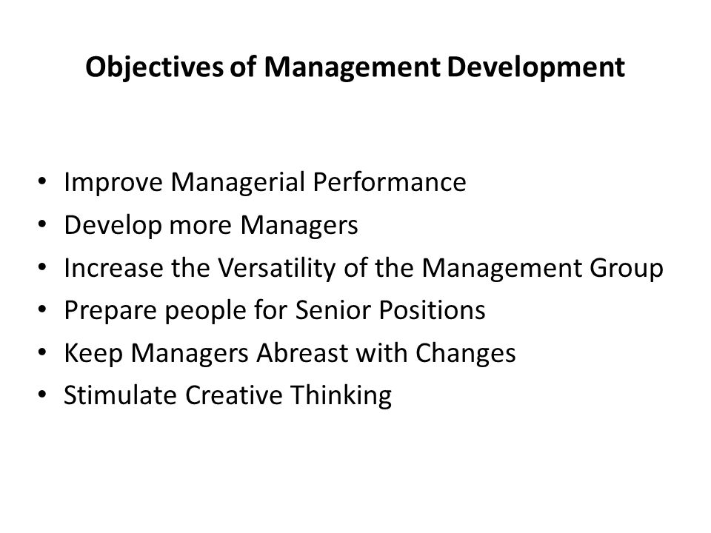

Slide 30
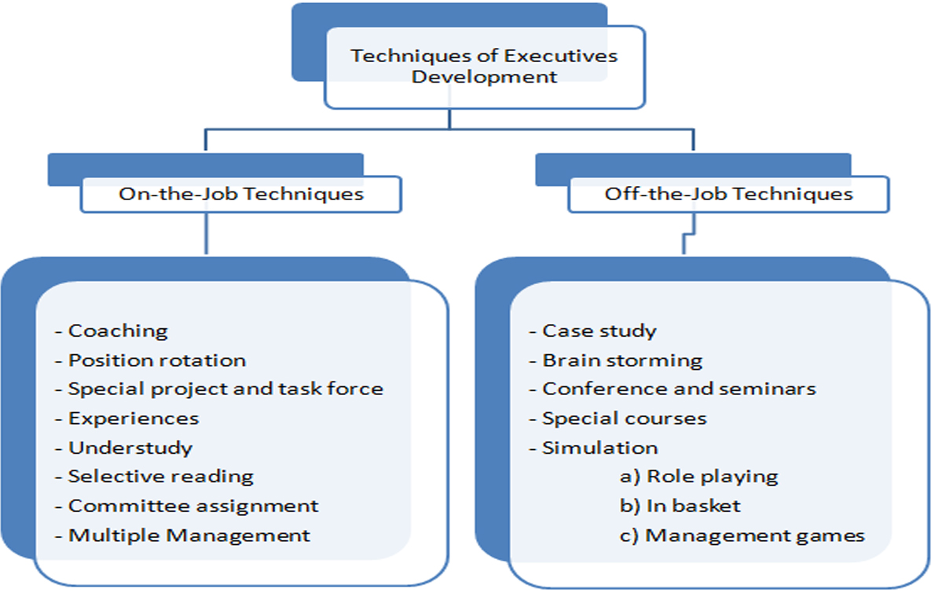

Slide 31
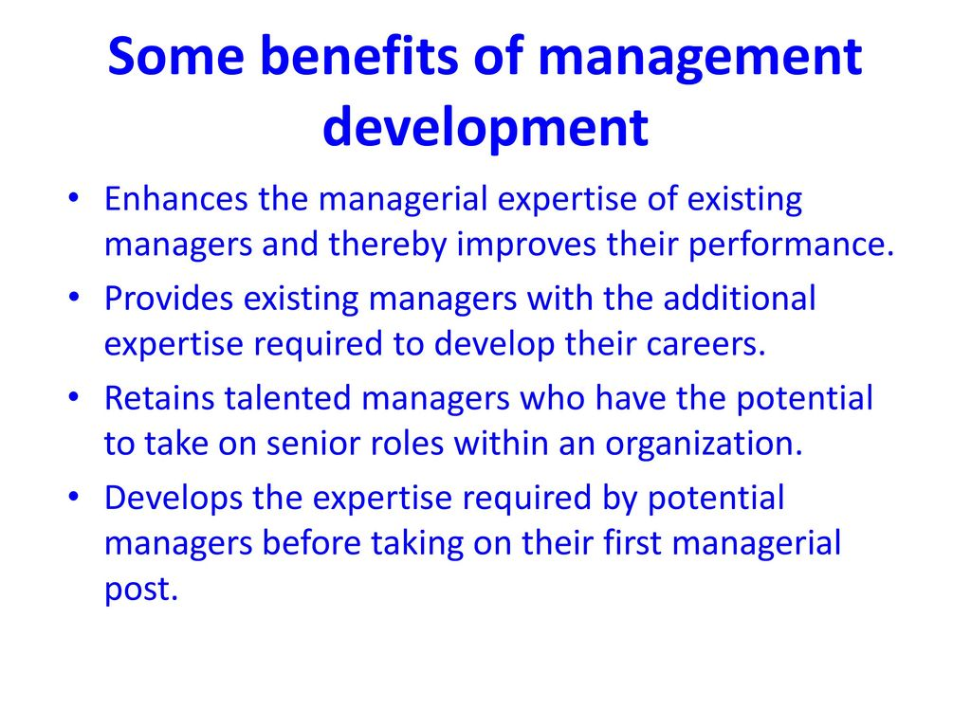

Slide 32


Slide 33
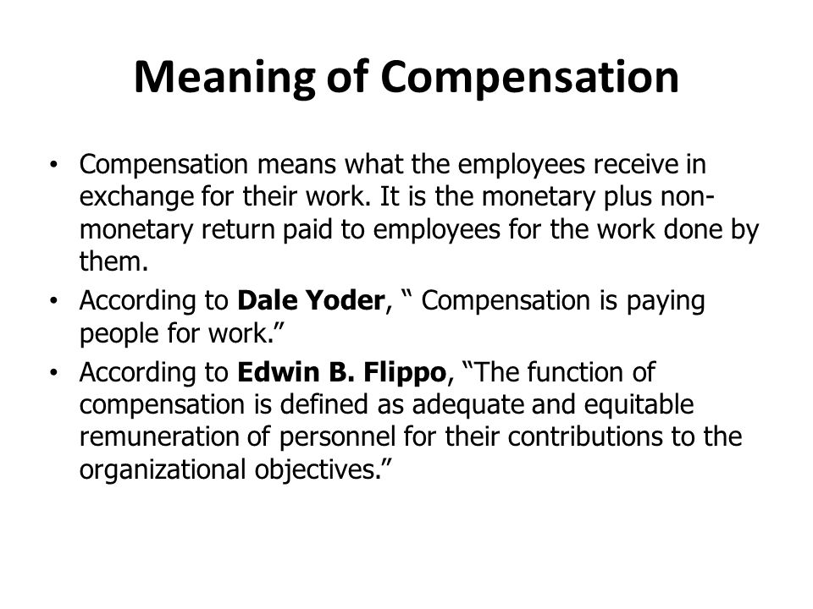

Slide 34
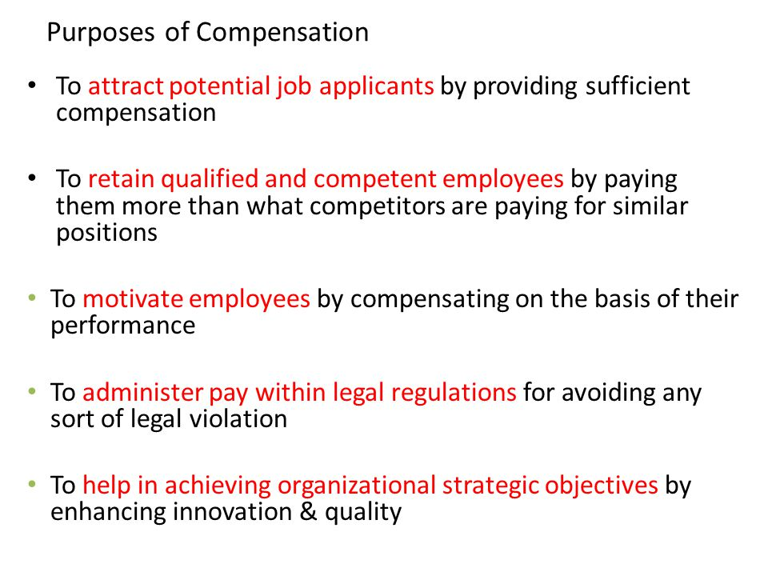

Slide 35
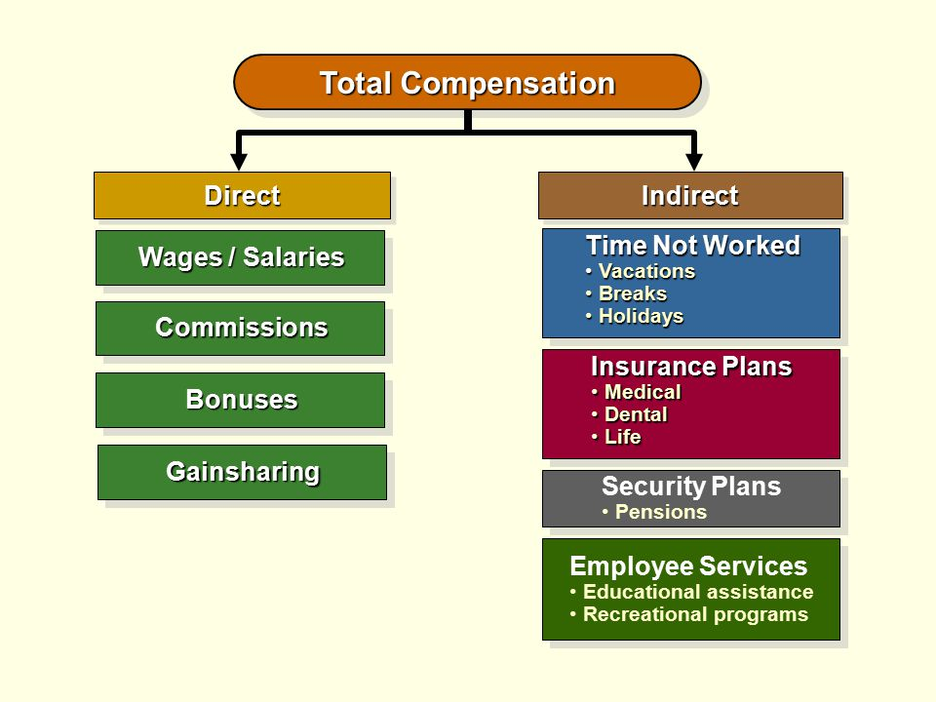

Slide 36

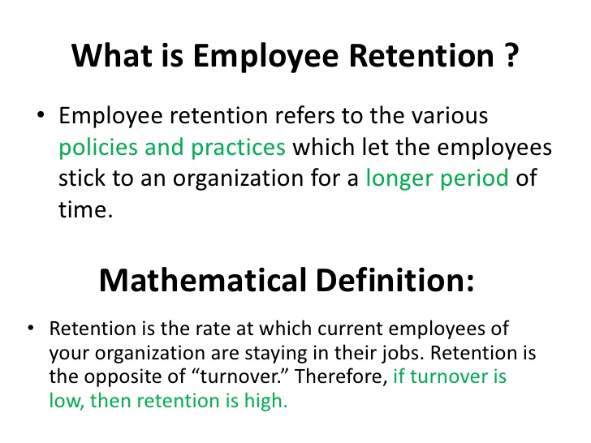

Slide 37
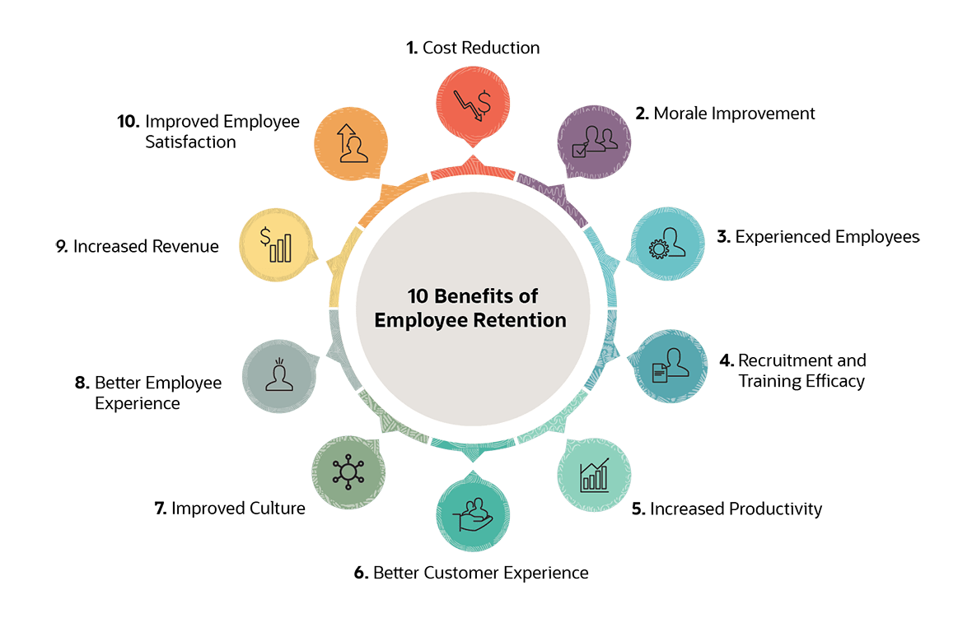

Slide 38
Reasons For RETENTION
Personal reasons.
Work-life balance
Incompatibility
Work relationships
Lack of opportunity
Financial reasons

Slide 39
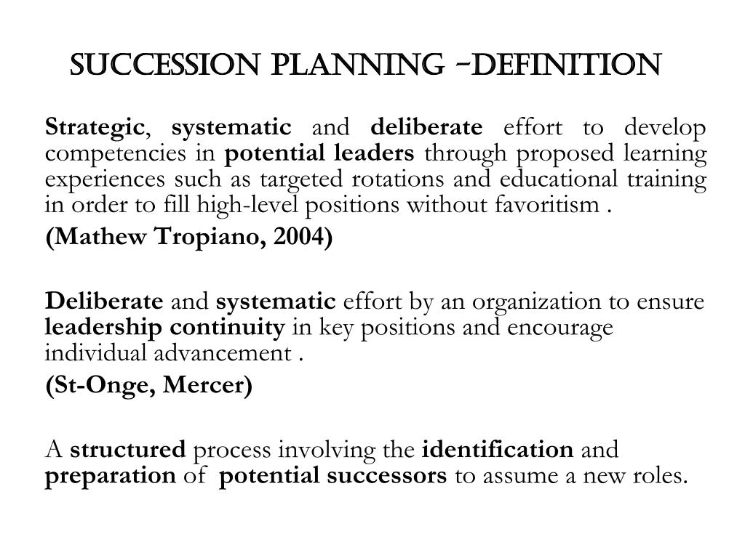

Slide 40
Benefits:
A means of ensuring the organization is prepared with a plan to support service continuity
when the executive director, senior managers or key people leave
A continuing supply of qualified, motivated people (or a process to identify them), who
are prepared to take over when current senior staff and other key employees leave the
organization
An alignment between your organization's vision and your human resources that
demonstrates an understanding of the need to have appropriate staffing to achieve
strategic plans
A commitment to developing career paths for employees which will facilitate your
organization's ability to recruit and retain top-performing employees and volunteers
An external reputation as an employer that invests in its people and provides
opportunities and support for advancement
A message to your employees that they are valuable

Slide 41
Succession planning process:
1 – Identify Key Positions
Analyse business plans to identify the positions most critical for business growth.
2 – Identify Potential Successors
Establish the key competencies required to undertake these roles and the high potential employees that could step up and assume these positions.
3 – Determine When Will The Potential Successors Be Ready
Recognize the timeframe of your successor’s readiness to take on the role. Are they ready to commence development now? In the short term? Or, in the long term?
4 – Determine What Development Needs Do They Have
Determine the training and development required to fill skill gaps and prepare them for advancement. This can include mentoring, secondments, on the job training as well as external courses.
5 – Ensure An Ongoing Commitment
Managers in all parts of the organisation should be continually identifying gaps in talent and focusing on the development of high performers.

Slide 42
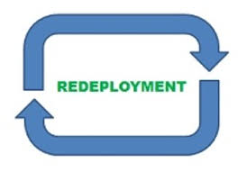
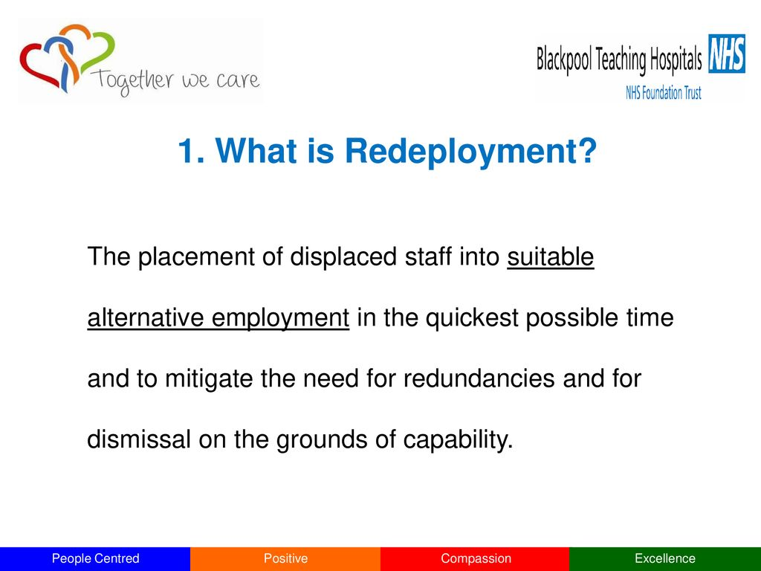
Redeployment is the process of moving people within the organization and from units where there are excess employees to the departments where there is shortage.

Slide 43
Process of Redeployment:
Maintain an up to date Redeployment Register
Make exporting managers and employees aware of suitable vacancies
Ensure redeployees are given first priority for any vacancies
Provide relevant support to candidates in the company Jobs
Confirm offers of suitable work trials and successful redeployment
Pay protection
Support managers throughout and keep them fully briefed

Slide 44
Benefits of Redeployment:
Lower Costs
Improves Corporate Brand
Improves The Relationship Between Employees and Employers
Promotes a Positive Company Culture
Improves Talent Retention

Slide 45
Performance appraisal
Dale S. Beach, “Performance appraisal is systematic evaluation of the individual with respect to his or her performance on the job and his or her potential for development”.
Dale Yoder, ”Performance appraisal includes all formal procedures used to evaluated personalities and contributions and potentials of group members in a working organisation. It is a continuous process to secure information necessary for making correct and objective decisions on employees.”

Slide 46
Objectives of Performance Appraisal:
To maintain records in order to determine compensation packages, wage structure, salaries raises, etc.
To identify the strengths and weaknesses of employees to place right men on right job.
To maintain and assess the potential in a person for growth and development.
To provide a feedback to employees regarding their performance and related status.
It serves as a basis for influencing working habits of the employees.
To review and retain the promotional and other training programmes.

Slide 47
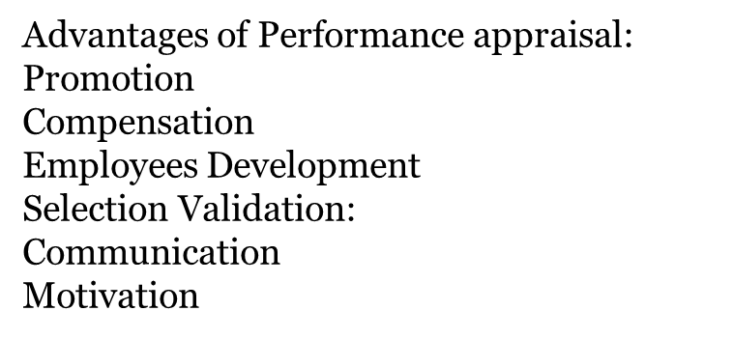

Slide 48
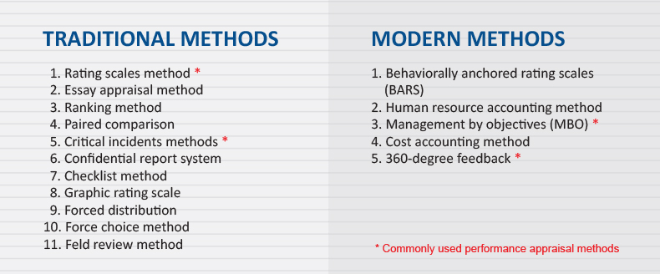

Slide 49

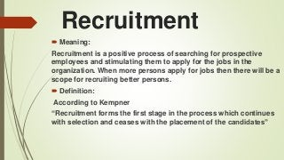

Slide 50
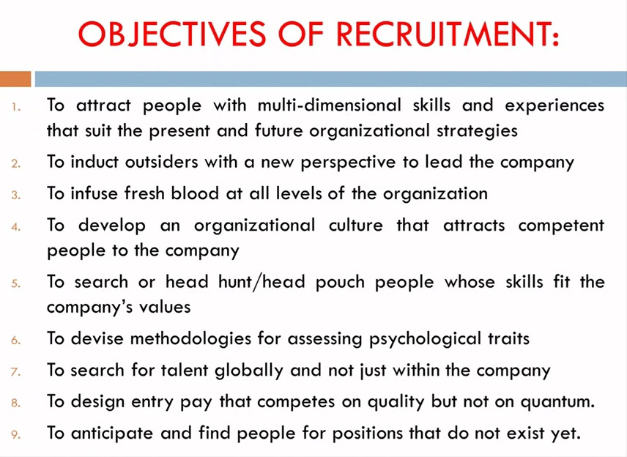

Slide 51
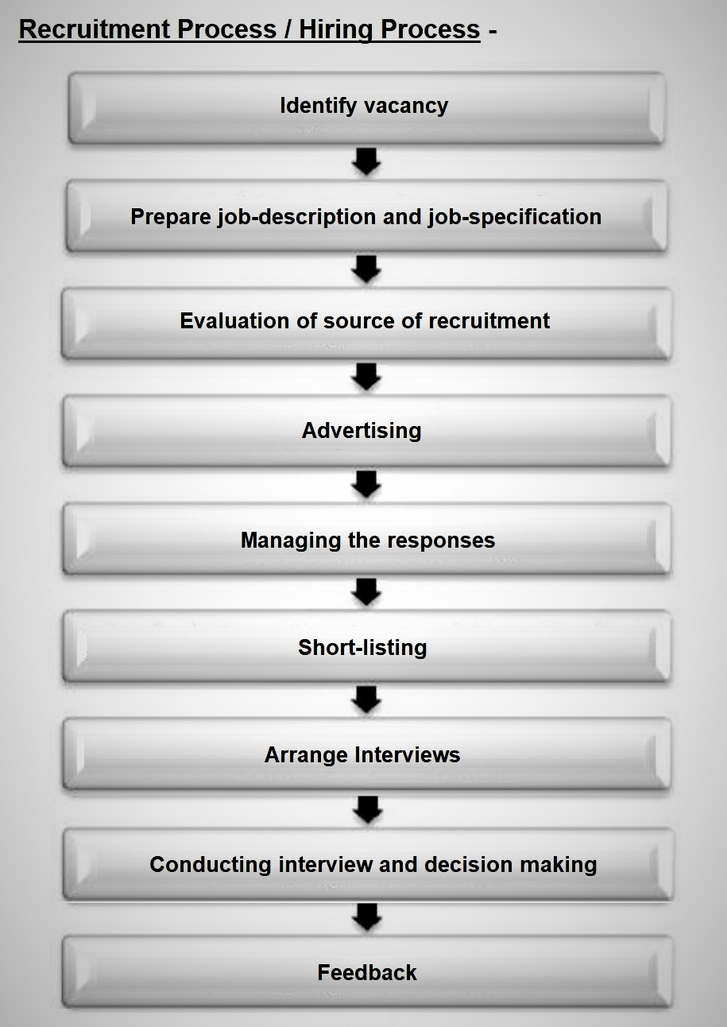

Slide 52
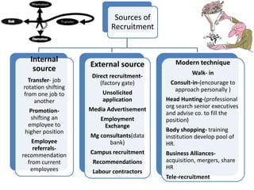

Slide 53
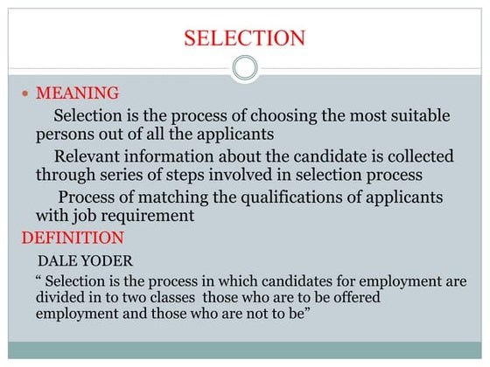
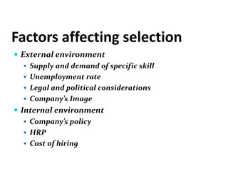

Slide 54
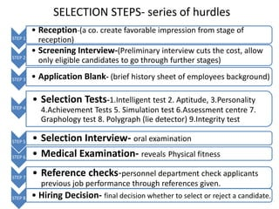

Slide 55
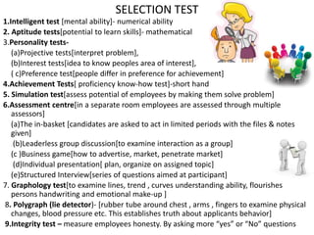

Slide 56
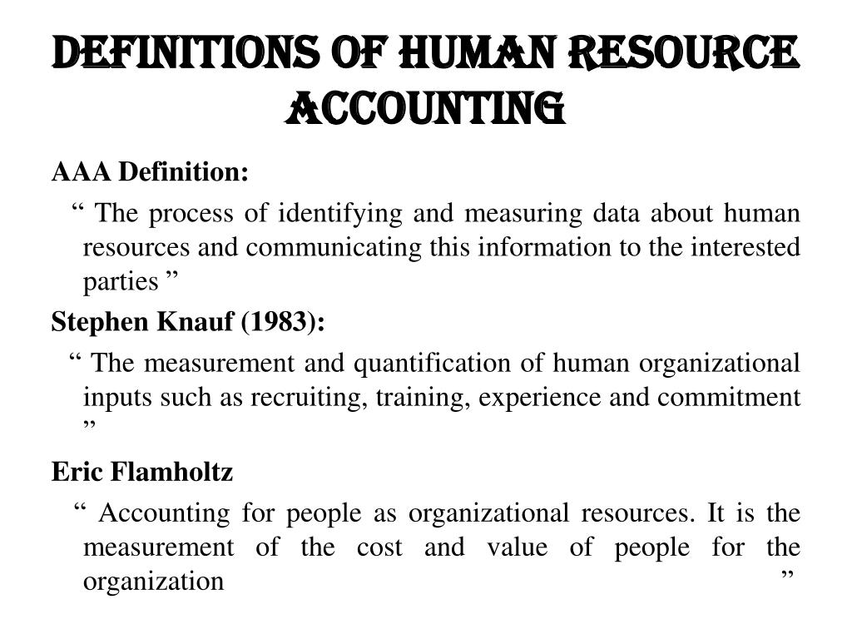

Slide 57
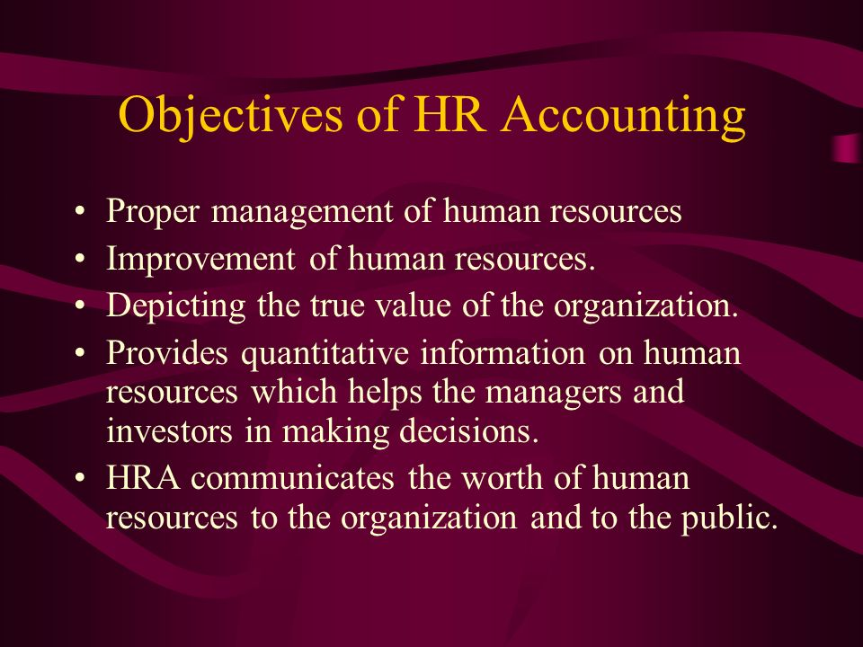

Slide 58
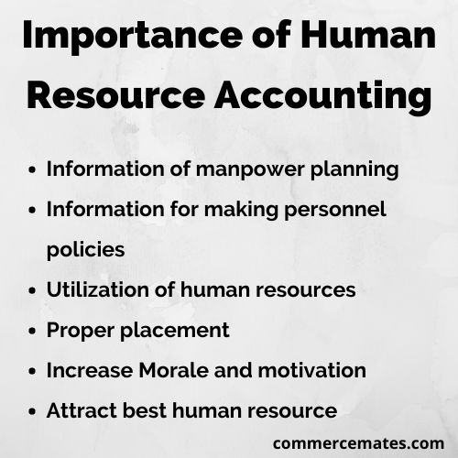

Slide 59

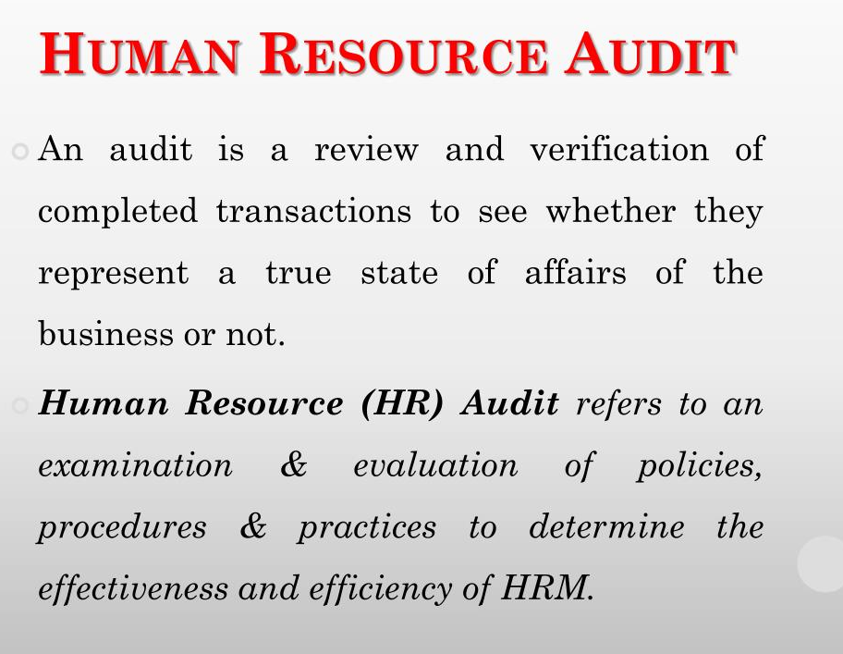

Slide 60
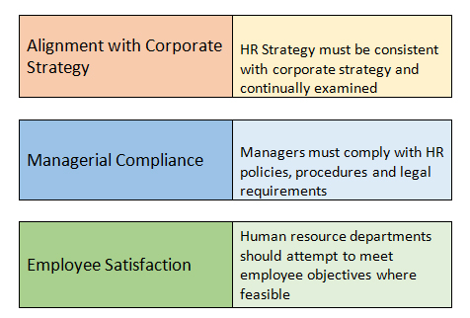

Slide 61
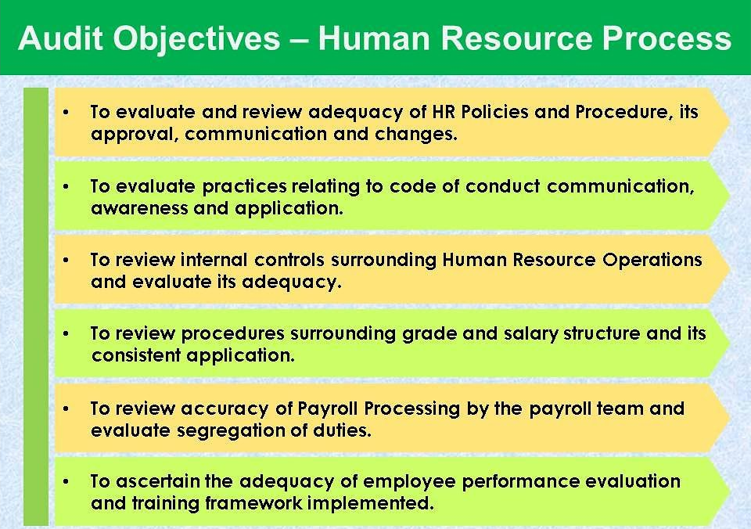

Slide 62
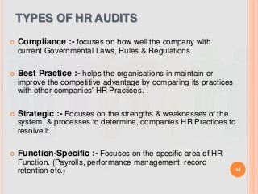

Slide 63
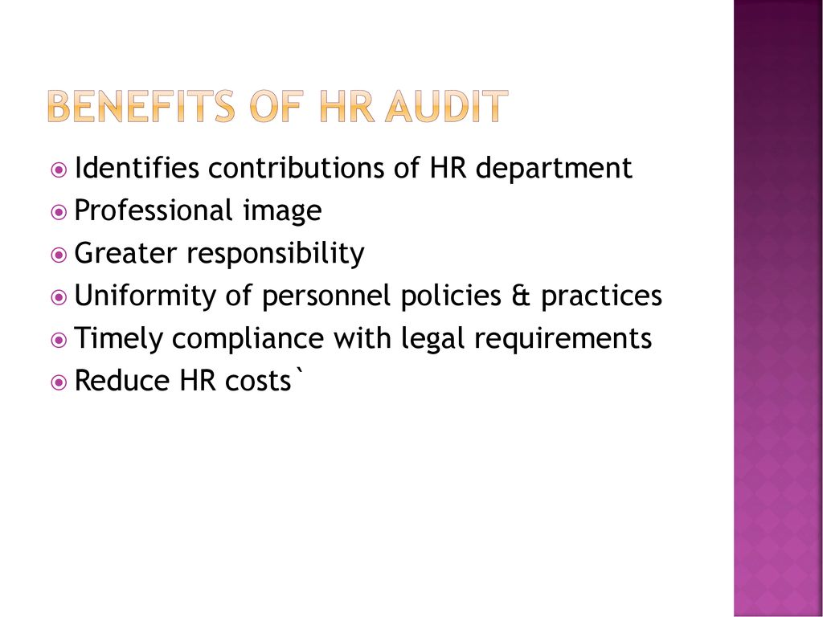

Slide 64


Slide 65




HUMAN RESOURCE INFORMATION SYSTEM

Slide 66


Slide 67


Slide 68
Types of HRIS
Operational HRIS
Operational HRIS systems collect and report human resource data such as employee records, position details, and performance appraisal information. They help provide HR managers with the data they need to perform tasks such as performance management, promotions, hiring, and internal personnel changes.
Tactical HRIS
Tactical HRIS systems are involved in processes related to the use of resources. This includes recruiting, training, compensation, vacancies, and so on. These are more useful for making big-picture decisions about resource allocation, job analyses, and team development. In addition to internal figures, tactical HRIS systems also deal with data such as union information, competitor data, government requirements, etc.
Strategic HRIS
Just like it sounds, strategic HR data systems help with strategic analysis and decision-making. They assist HR professionals with functions like goal-setting and future workforce planning. Strategic HR systems can help with awareness regarding available labor resources and proper workforce planning by managing data like market information and operations budgets.
Comprehensive HRIS
A comprehensive HRIS is somewhat of a combination of the above types, involved in all things human resources, including operational, tactical, and strategic matters. It works as a streamlined database and platform to offer easy review and management of a variety of HR-related tasks and areas, including:
Team member information
HR files
Open positions
Recruitment and hiring details
Job analysis and design
Safety guidelines
Skills inventory
Compensation and benefits
Training and development
Performance management
Limited-Function HRIS
Unlike a comprehensive HRIS, a limited-function HRIS serves one purpose only. These systems are not necessarily made for strategic planning or management. Instead, their functions are more concrete and granular. The exact function of each limited-function HRIS depends on the particular system. For example, an HRIS might be created specifically for training or benefits management.

Slide 69


BambooHR, Workday, Rippling, Gusto, Deel, Paycor, HiBob, and SAP

Slide 70


Payroll refers to the process of calculating and distributing salaries or wages to employees of an organisation. It includes maintaining records of employee earnings, deductions (like taxes, provident fund, and insurance), bonuses, and net pay.
Payroll management is the crucial process of compensating employees by managing salaries, wages, bonuses, and all related deductions like taxes and benefits, ensuring accurate, timely, and compliant payments to maintain employee satisfaction and meet legal requirements.
It involves tracking employee information, calculating total pay, withholding necessary amounts, and disbursing payments, often using specialized software to automate these complex tasks.

Slide 71
Key Aspects of Payroll Management:
Employee Data Management:
Keeping employee personal and salary details up-to-date.
Time Tracking:
Monitoring employee hours, attendance, and overtime for accurate calculation.
Salary Calculation:
Determining gross earnings, allowances, bonuses, and calculating net pay.
Deductions and Withholding:
Calculating and withholding taxes, pension contributions, and other deductions.
Compliance:
Ensuring all payroll processes adhere to national and local tax laws and labor regulations.
Disbursement:
Facilitating timely and accurate payment to employees, often through direct deposit.
Reporting:
Generating various reports, such as salary slips and financial statements, for employees and management.

Slide 72


Slide 73
Benefits of Effective Payroll Management:
Accuracy and Efficiency:
Minimizes errors and saves time by automating routine tasks.
Legal Compliance:
Ensures adherence to tax laws and prevents penalties and legal issues.
Improved Employee Morale:
Fosters trust and satisfaction by providing accurate and timely payments.
Enhanced Employee Relations:
Promotes transparency in salary transactions, which can help employees with financial matters like loans.
Reduced Turnover:
Accurate and reliable payroll contributes to employee retention and a positive work environment.

Slide 74
Limitations of Payroll Systems:
Data Security and Privacy:
Payroll systems handle sensitive employee data, making them targets for security breaches. Inadequate security measures can lead to unauthorized access and data leaks.
Integration Challenges:
Connecting a payroll system with other business software, such as accounting or HR systems, can be complex and may require significant development or customization.
Complexity and Versatility:
Complex business structures, international payrolls, or unique employee benefits can make it difficult for a single payroll system to be universally versatile enough to handle all situations.
High Costs:
While automated systems save time and money in the long run, the initial investment in software, implementation, and training can be a significant financial burden.
Human Error:
Even with automation, incorrect data input, misinterpretation of complex regulations, or system misconfiguration can still lead to errors in calculations and payments.

Slide 75


“Strategic human resource management means formulating and executing human resource policies and practices that produce the employee competencies and behaviors that the company needs to achieve its strategic aims.”- Gary Dessler
Strategic human resource management (SHRM) is defined as “the pattern of planned human resource deployments and activities intended to enable an organization to achieve its goals”. – Wright & McMahan

Slide 76


Slide 77
Objectives:
1. To set the goals: To set the goals of an organization with respect to human resources.
2. To utilize human resources: To identify the strategic needs of an organization & its utilization.
3. To select the type: To select the appropriate organ gram for the organization.
4. Compensation plan: To set the appropriate & suitable compensation system for the employees.
5. To set the evaluation standard: To set the performance evaluation method & the standard.
6. To identify the relationships: To identify the relationships among the different departments & setting their duties & responsibilities.

Slide 78
7. To set strategies for future challenges: Organizations should set some strategies’ to survive in the competition.
8.To formulate the HR policies: The HR manager is supposed to take action in this regard.
9. To review the existing HRM practices: Employee needs and workability of HRM policies are to be reviewed regularly.
10. To develop guidelines: The last objective of SHRM is to develop guidelines for the human resource manager.

Slide 79


Slide 80


Slide 81



Slide 82
Strategic Fit
• Best fit is more important than best practice.
• HR Strategies
• Match Org culture • Consider need of people & Org
• Should meet the requirements
• Fulfill plans
• External fit and internal fit

Slide 83
Vertical fit:
• This aspect of vertical fit concerns the coincidence between HR practices and overall business strategy.
Horizontal fit:
• This relates to the extent to which HR activities are mutually consistent. Consistency ensures that HR practices reinforce one another.
External fit:
• The third aspect concerns how well HR activities match the demands of the external environment. Ensuring these aspects of fit requires HR practice choices. The challenge is to develop internally consistent configurations of HR practice choices that help to implement the firm’s strategy and enhance its competitiveness.
• There is a need for strategic flexibility along with a strategic fit for the long-term competitive advantage of the firm.

Slide 84


Slide 85


Slide 86


Slide 87




Slide 88


Slide 89


Slide 90


Slide 91


Slide 92


Slide 93

EMPLOYEE EMPOWERMENT AND CUSTOMER SATISFACTION

Slide 94


Slide 95


Slide 96


Slide 97



Slide 98


Slide 99


Slide 100


